Slide 1
Risk and Race
Reimagining the Future of RNR

Slide 2
AGENDA
The History and Rise of Risk Assessment
Defining Risk and Risk Theory
​Use in Treatment and Sentencing
Risk and Racial Bias
​Where Do We Go From Here?
Measuring Treatment-Based Outcomes

Slide 3
A History of Risk
Risk is the likelihood of a negative occurrence
Risk assessment is a process to identify potential hazards and analyze what could happen if a hazard occurs
Humans have used risk prediction for hundreds of years; 1600s probability theory in gambling, identifying risk of hazards and losses
Modern use of Risk Assessment:
Risk of heart disease
Risk of hurricane impact
Risk of nuclear accidents
Risk of collision for insurance purposes
Risk of wildfires
Risk of COVID exposure
Notes:
History – athenians? Renesainnce development of probability theory 1600s used to identify the mathematical odds of winning during gambling, over many years these mathematics were developed to begin identifying the risks of hazards and losses, this has increased overtime as societies have continued to gather and collect larger amounts of information that can be used to statistically calculate the likelihood of certain outcomes. Has moved modern societies into identifying risks, assessing and anlayzing their likelihood of occurring, and finding solutions to manage or mitigate those risks. https://www.youtube.com/watch?v=96_I4wEoTjM
Nuclear Power Plants - https://media.rff.org/archive/files/sharepoint/WorkImages/Download/RFF-Resources-172_Risk_Assessment.pdf Original studies in the 70s were voided and revisited. Nuclear Reactor falls outs
*While there are many definitions of the word risk, EPA considers risk to be the chance of harmful effects to human health or to ecological systems resulting from exposure to an environmental stressor.

Slide 4
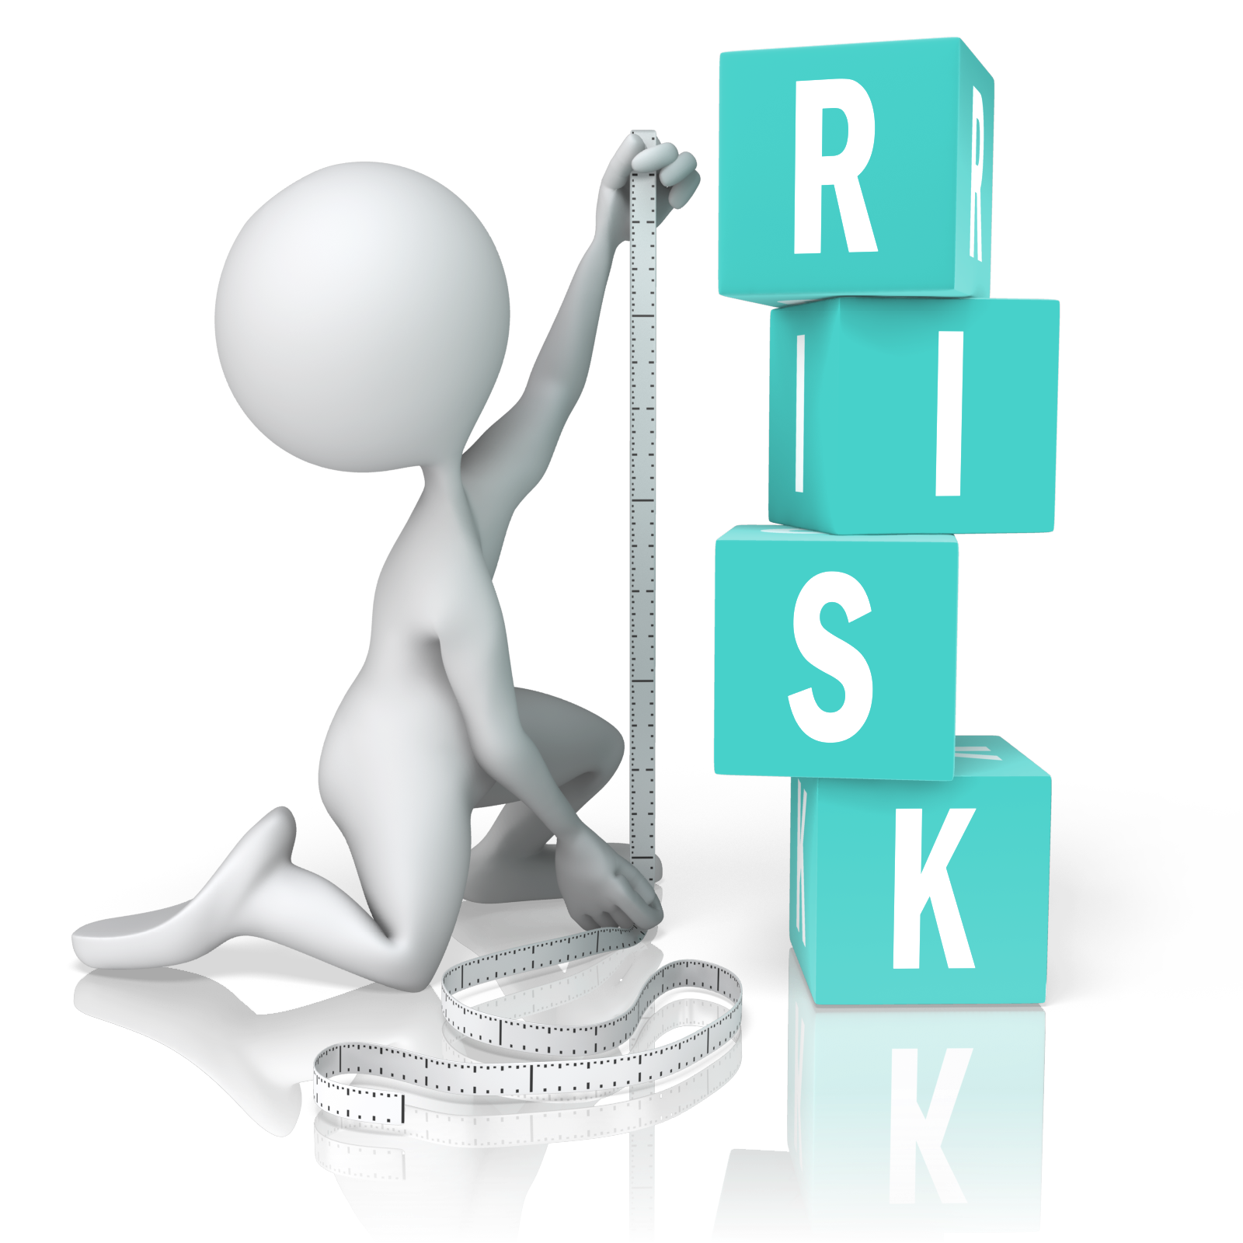
Rise of Risk Assessment in Criminal Justice
First risk assessments in criminal justice were in the 1900s. Correctional staff used to assign risk of reoffending and were entirely judgement based.
The first actuarial parole prediction instruments date back to 1930s in Illinois but became more commonplace in the 1970s and 80s.
Third wave of risk assessment developed in 1980s and 90s that focused on rehabilitating individuals and reducing recidivism through identifying their needs and being responsive in addressing them.
Substantial increases in the use of tools.
Notes:
https://bja.ojp.gov/program/psrac/basics/history-risk-assessment
1900s first assessments were professional judgments made by clinical or correctional staff relying on their personal training and experience. Absent structured criteria or checklists, professionals examined an individual’s characteristics or behavior and assessed the likelihood of reoffending (or of justice noncompliance, such as failure to appear at trial).
Originating in the 1920s, actuarial assessments of risk to reoffend became increasingly commonplace in criminal justice agencies, particularly during the 1970s and 1980s. These second generation risk assessments were numeric predictions derived from analyses of static risk factors. The first actuarial tool was developed for the Illinois parole system (Burgess, 1936[C]) and used marital status, criminal and employment history, and institutional misconduct to assess the likelihood of reoffending; calculations were based on analyses of data for 3,000 individuals paroled in Chicago. For a simplified example of this tool, see What is risk assessment Since that time, second generation tools have been widely used to inform criminal justice decision-making (e.g., Salient Factor Scale[C] by the U.S. Parole Commission) and are still prevalent among criminal justice agencies.
Compared to the first generation risk assessments, the primary benefit of second generation risk assessments is the incorporation of structured, objective, and evidence-based criteria for assessing risk to reoffend, which emerged as more accurate and reliable[C] than professional judgments alone. The key drawback is their inability to capture dynamic changes in individuals’ attitudes, behaviors, and needs over time.
*Illinois assessment was 50% accurate? [source]
Beginning in the 1970s there was a growing recognition that the assessment of risk needed to depend more upon actuarial, evidence-based science and less on professional judgement. Actuarial risk assessment instruments consider individual items (e.g., history of substance abuse) that have been demonstrated to increase the risk of reoffending and assign these items quantitative scores. Before long it became clear that these actuarial risk assessment instruments were better at predicting criminal behaviour than professional judgement. Research reviews repeatedly showed that actuarial instruments performed better than clinical or professional judgement when making predictions of human behaviour. As a consequence of the predictive superiority of actuarial risk assessments, more and more correctional jurisdictions adopted this type of assessment for classifying offenders and assigning differential supervision practices. The period between 1970 and 1980 saw a movement from what Bonta (1996) called first generation assessment.
Second generation, actuarial risk assessment instruments have demonstrated satisfactory results; they can reliably differentiate lower risk offenders from higher risk offenders. However, second generation actuarial instruments have two characteristics that present major shortcomings. First, the second generation risk assessment instruments are atheoretical. The items that create these instruments are chosen simply because they are easily available and show an association with recidivism. The items are not chosen because they are theoretically relevant. Thus, the majority of the items are criminal history items – the type of information that correctional systems are quite efficient at collecting and distributing.
The second characteristic of second generation instruments is that the non-criminal history items that sample behaviour also tend to be of a historical nature (e.g., history of drug abuse). Criminal history and other factors that sample past behaviour are treated as static, immutable risk factors. This poses a major shortcoming for second generation risk assessment because the scales do not account for offenders changing for the better. Rather, the possibilities are: a) an individual's risk level does not change (if one scored positive for a history of drug abuse that risk factor will always remain no matter if he/she has learned to abstain from drugs, or b) an individual's risk increases (e.g., new offences are committed and criminal history scores increase). There is no possibility for diminished risk (to be fair, some of the second generation instruments do have items that can account for some diminished risk, however the number of items represent a minority of items in these risk scales).
The third generation of risk assessments incorporated theoretically derived, dynamic factors linked directly to criminal behavior, labeled as criminogenic needs[C]. Because criminogenic needs are changeable and related to reoffending, their incorporation into risk assessments helps practitioners target and monitor risk reduction efforts. Notably, third generation risk assessments were developed in direct support of the risk-need-responsivity principles[C], which argue that rehabilitation efforts will be effective when they match the level of risk, type of criminogenic need, and learning style and motivations (responsivity) of the individual being treated. In other words, people at high-risk to reoffend with many potentially changeable criminogenic needs should be targeted for the strongest rehabilitation efforts. By contrast, minimal efforts should be reserved for those at low-risk and those with few criminogenic needs.
Third wave developed by reasearcers in Canada Developed in the 1980s and first formalized in 1990, the risk-need-responsivity model has been used with increasing success to assess and rehabilitate criminals in Canada and around the world. As suggested by its name, it is based on three principles: 1) the risk principle asserts that criminal behaviour can be reliably predicted and that treatment should focus on the higher risk offenders; 2) the need principle highlights the importance of criminogenic needs in the design and delivery of treatment; and 3) the responsivity principle describes how the treatment should be provided.- https://www.publicsafety.gc.ca/cnt/rsrcs/pblctns/rsk-nd-rspnsvty/index-en.aspx
Third generation risk instruments were sensitive to changes in an offender's circumstances and also provided correctional staff with information as to what needs should be targeted in their interventions. There is now evidence that changes in the scores on some of these risk-need instruments are associated with changes in recidivism (Andrews & Robinson, 1984; Arnold, 2007; Motiuk, Bonta & Andrews, 1990; Raynor, 2007; Raynor, Kynch, Roberts & Merrington, 2000). Evidence of dynamic validity, that is, changes in risk scores signal changes in the likelihood of committing a new offence, is immensely important for correctional programs and the staff charged with managing offender risk. The third generation risk-need instruments offer a way of monitoring the effectiveness, or ineffectiveness, of programs and supervision strategies. Furthermore, because dynamic risk factors (e.g., substance abuse, employment, companions) are embedded in third generation instruments correctional staff can be guided in directing intervention to these dynamic risk factors. Successfully addressing these dynamic risk factors would contribute to an offender's reduction in risk (Bonta, 2002). https://www.publicsafety.gc.ca/cnt/rsrcs/pblctns/rsk-nd-rspnsvty/index-en.aspx

Slide 5
Defining Risk
In Criminal Legal Settings

Slide 6
Risk =
Probability of re-arrest for any charge
OR
Probability of committing violent re-offense
Probability of failure to appear (FTA) <- NOT flight!
Probability of intimate partner harm or homicide

Slide 7
Types of Risk Tools
Pretrial Risk Tools
Lethality Assessments
Risk Need Responsivity Tool

Slide 8
Pre-Trial Risk Tools
Most of the debate is around these tools
Measure:
Risk of reoffending
Risk of committing new violent offense
Risk of failure to appear
Use can affect:
Pretrial release
Intensity of pretrial supervision
Bail setting

Slide 9
Lethality Assessment
Partner Violence
Victim Focus
Danger
safety
Risk
Prevent intimate partner related homicides or injury
Tool is administered to identified victims
Look to identify the level of danger an abused person may be experiencing
Are used for case planning to reduce to reduce threats to safety
Uses risk to identify threats to safety
Notes:
https://thelaurelcenter.org/lethality-assessment/
https://www.nashville.gov/departments/police/investigative-services/interpersonal-crimes-branch/domestic-violence/risk

Slide 10
Risk Need Responsivity Tools
Risk Principle:
Who to Target
Need Principle:
What to TArget
Responsivity:
How to Target
Target intervention intensity according to someone's risk level
Assess and respond to criminogenic needs to reduce recidivism
Tailor interventions to the specific characteristics, culture, language, and learning style of the individual

Slide 11
Risk and Reducing Recidivism
Using Risk in Interventions and Treatment

Slide 12
The risk principle
Vary the intensity of intervention (treatment & supervision) by risk level.
High risk:
Provide more Intensive Interventions
Lower Risk:
Interventions can be harmful: why?
Interferes with work or school
Interferes with family obligations
Interferes with pro-social engagements
Supported by more than 400 studies!

Slide 13
Negative Effects of Intensive Interventions
Drug Treatment Programs
Review of 400 drug court participants in NYC
Placement of low-risk drug court participants in long-term residential treatment doubled their likelihood of re-arrest over a two-year follow up period.
Pretrial Alternatives to Detention
Review of federal criminal offenses from 2001-2007
Lower risk defendants were MORE likely to result in pretrial failure than high-risk defendants. Defendants were over supervised.

Slide 14
Risk-Need Based Interventions
High Risk/High Need
Higher intensity interventions
High Risk/Low Need
Address criminogenic thinking and behavior
Low Risk/High Need
BREIF Intervention and voluntary referral to services
Low Risk/Low Need
OFF-Ramp

Slide 15
Risk & Racial Bias

Slide 16
Racial & Ethnic Disparities
Risk assessment has the potential to reduce or exacerbate disparities

Slide 17
Why is that?
Decrease Bias:
Limits bias and problematic discretion in judges and prosecutors
When done properly – it can guide outcomes towards higher release rates for Black and Brown defendants
When paired with a needs assessment can be used to provide supportive interventions

Slide 18
Why is that?
Increase Bias:
Bakes system bias into the risk scores
Can be less accurate for Black and Brown individuals
Can result in higher punitive sanctions or collateral consequences if there is mis-classification of risk

Slide 19
Research is Mixed
Two approaches
Risk levels associated with increasing recidivism regardless of race
Decisions based on RNR produces less biased outcomes
Research is still developing on racial disparity at the item level
Huang et al. (2020) found fairly large disparity in certain items
YLS was not predictive of recidivism for non-Indigenous youth

Slide 20
Is the Tool Increasing or decreasing Disparities?
How to know if a tool is doing more harm than good

Slide 21
Three considerations
The tool
Where is the tool used
How is it being used
Is the tool itself perpetuating bias?
The point in the CL system the tool is used can influence the collateral consequences of bias.
Human use of the tool can compound biased outcomes for individuals.

Slide 22
1) Is the Tool biased?
A) Race is not included as question in the calculations
B) Factors included are not a proxy for race
C) The algorithm performs similarly across racial and ethnic groups

Slide 23
How do we know if a factor is a proxy???
1.B

Slide 24
Risk Factors
Static risk factors
Criminal history
# of arrests
# of convictions
type of offenses
Current charges
Age at first arrest
Current age
Gender
Dynamic risk factors
Antisocial attitudes
Antisocial friends & peers
Criminal Thinking
Family/marital factors
Education/poor employment history
Pro-social leisure activities
Substance use and misuse
Are These Proxies?
Notes:
Mental Health – Responsivity
Housing
Trauma

Slide 25
Criminal history
Is this a proxy?

Slide 26
How Bias is in the numbers
Arrest
Charging
Plea
Sentencing
Probation
BIPOC Higher rates of arrest
BIPOC Given Higher Charges for similar offenses
BIPOC More likely to take unfavorable pleas because of income
BIPOC More likely to receive higher sentences for same crime
BIPOC More likely to have revocation or probation or parole for violations

Slide 27
Study of criminal cases in NYC 2019
Black New Yorkers accounted for 51% of all felony charges and 50 % of all misdemeanor charges
Black New Yorkers accounted for more than 2x their representation in the city’s general population
Prison sentences were more prevalent among Black (58%) and Hispanic/Latinx (56%) than white (43%) people convicted of a felony (Butcher et al., 2022)

Slide 28
Sources
Rebecca C. Hetey, and Jennifer L. Eberhardt, “The Numbers Don’t Speak for Themselves: Racial Disparities and the Persistence of Inequities in the Criminal Justice System.” Association for Phycological Science 27 no. 3 (2018): 183. https://doi.org/10.1177/0963721418763931
Susan Nembhard, and Lily Robin, “Racial and Ethnic Disparities Throughout the Criminal Legal System: A Result of Racist Policies and Discretionary Practices.” Urban Institute (August 2021): 3-4. https://www.urban.org/sites/default/files/publication/104687/racial-and-ethnic-disparities-throughout-the-criminal-legal-system.pdf
Sentencing Project. “Report to the United Nations on the Racial Disparities in the US Criminal Justice System April 19, 2018.” Accessed March 6, 2023. https://www.sentencingproject.org/reports/report-to-the-united-nations-on-racial-disparities-in-the-u-s-criminal-justice-system/
Beth Redbird, “Racial Disparity in Arrests Increased as Crime Rates Declined.” Northwestern Institute for Policy Research Working Paper Series 20 no. 28 (June 18, 2020): 10. https://www.ipr.northwestern.edu/documents/working-papers/2020/wp-20-28.pdf
Jacqueline L. Jahn, Jessica T. Simes, Tori L. Cowger, and Bridgette A. Davis, “Racial Disparities in Neighborhood Arrest Rates During the COVID-19 Pandemic.” Urban Health 99 no. 1 (February 2022): 67-76. https://www.ncbi.nlm.nih.gov/pmc/articles/PMC8751464/
Arrest

Slide 29
Sources
Matthew L. Mizel, “A Plea for Justice: Racial Bias in Pretrial Decision Making.” PhD. diss., University of California, Los Angeles, 2018, 9-10. https://escholarship.org/content/qt7dg565rr/qt7dg565rr_noSplash_adeea7047d87f44da89b229c71274933.pdf
Susan Nembhard, and Lily Robin, “Racial and Ethnic Disparities Throughout the Criminal Legal System: A Result of Racist Policies and Discretionary Practices.” Urban Institute (August 2021): 4-5. https://www.urban.org/sites/default/files/publication/104687/racial-and-ethnic-disparities-throughout-the-criminal-legal-system.pdf
Berdejó, Carlos, “Criminalizing Race: Racial Disparities in Plea Bargaining.” Boston College Law Review, Vol. 59, 2018, Loyola Law School, Los Angeles Legal Studies Research Paper No. 2017-39. https://ssrn.com/abstract=3036726
Lindsey Devers, “Plea and Charge Bargaining: Research Summary.” Bureau of Justice Assistance US Department of Justice (Jan 24, 2011). https://bja.ojp.gov/sites/g/files/xyckuh186/files/media/document/PleaBargainingResearchSummary.pdf
Sonjya B. Starr, and M. Marit Rehavi, “Mandatory Sentencing and Racial Disparity: Assessing the Role of Prosecutors and the Role of Booker.” Yale Law Journal 123 no. 2 (2013): 7 https://www.yalelawjournal.org/pdf/1206_ecd3dkoj.pdf
Charging/
Plea Bargaining

Slide 30
Sources
Ojmarrh Mitchell, and Doris L. MacKenzie, “The Relationship Between Race, Ethnicity, and Sentencing Outcomes: A Meta Analysis of Sentencing Research.” United Stated Department of Justice (2004): 3 https://www.ojp.gov/pdffiles1/nij/grants/208129.pdf
“Racial Disparities in Sentencing in the United States, July 14, 2022, 107th Session of the UN Committee on the Elimination of Racial Discrimination.” Sentencing Project, and ACLU (2022). https://www.sentencingproject.org/policy-brief/shadow-report-to-the-united-nations-on-racial-disparities-in-sentencing-in-the-united-states/
Traci Burch, “Skin Color and the Criminal Justice System: Beyond Black and White Disparities in Sentencing.” Journal of Empirical Legal Studies 12 no. 3 (September 2015): 408. https://onlinelibrary.wiley.com/doi/epdf/10.1111/jels.12077
Sentencing Project. “Report to the United Nations on the Racial Disparities in the US Criminal Justice System April 19, 2018.” Accessed March 6, 2023. https://www.sentencingproject.org/reports/report-to-the-united-nations-on-racial-disparities-in-the-u-s-criminal-justice-system/
“Demographic Differences in Sentencing: An Update to the 2012 Booker Report.” United States Sentencing Commission (November 2017): 6. https://www.ussc.gov/sites/default/files/pdf/research-and-publications/research-publications/2017/20171114_Demographics.pdf
M. Marit Rehvai, and Sonja B. Starr, “Racial Disparity in Federal Criminal Sentences.” Journal of Political Economy 122 no. 6 (2014): 1320. https://repository.law.umich.edu/articles/1414/
Sentencing

Slide 31
Sources
Sentencing Project. “Report to the United Nations on the Racial Disparities in the US Criminal Justice System April 19, 2018.” Accessed March 6, 2023. https://www.sentencingproject.org/reports/report-to-the-united-nations-on-racial-disparities-in-the-u-s-criminal-justice-system/
Kendra Bradner, and Vincent Schiraldi, “Racial Inequities in New York Parole Supervision.” Columbia University Justice Lab (March 2022):1. https://justicelab.columbia.edu/sites/default/files/content/NY%20Parole%20Racial%20Inequities.pdf
Susan Nembhard, and Lily Robin, “Racial and Ethnic Disparities Throughout the Criminal Legal System: A Result of Racist Policies and Discretionary Practices.” Urban Institute (August 2021): 6-7. https://www.urban.org/sites/default/files/publication/104687/racial-and-ethnic-disparities-throughout-the-criminal-legal-system.pdf
Jesse Janetta, Justin Breaux, and Helen Ho, “Examining Racial and Ethnic Disparities in Probation Revocation, Summary of Findings and Implications from a Multisite Study.” Urban Institute (April 2014): 3. https://www.urban.org/sites/default/files/publication/22746/413174-Examining-Racial-and-Ethnic-Disparities-in-Probation-Revocation.PDF
Susan Nembhard, and Lily Robin, “Racial and Ethnic Disparities Throughout the Criminal Legal System: A Result of Racist Policies and Discretionary Practices.” Urban Institute (August 2021): 6. https://www.urban.org/sites/default/files/publication/104687/racial-and-ethnic-disparities-throughout-the-criminal-legal-system.pdf
Probation
Parole

Slide 32
How Bias is in the numbers
Arrest
Charging
Plea
Sentencing
Probation
BIPOC Higher rates of arrest
BIPOC Given Higher Charges for similar offenses
BIPOC More likely to take unfavorable pleas because of income
BIPOC More likely to receive higher sentences for same crime
BIPOC More likely to have revocation or probation or parole for violations

Slide 33
How Bias is in the numbers
Probation
Sentencing
Plea
Charging
Arrest
BIPOC Higher rates of arrest
BIPOC Given Higher Charges for similar offenses
BIPOC More likely to take unfavorable pleas because of income
BIPOC More likely to receive higher sentences for same crime
BIPOC More likely to have revocation or probation or parole for violations

Slide 34
Can Dynamic Factors Be Proxies?

Slide 35
Recent Work on the OYAS
Miller et al. (2021)
Sullivan et al. (2022)
Miller et al. (2023)
Criminal History items predicted recidivism in White boys but nobody else
Remove Criminal History items?
Confirmatory factor analysis
Conceptualization of the OYAS as a total score maybe problematic
Subscales may not be comparable across racial groups
Item response theory
Pro-social items had low difficulty
May be characteristic of JJI youth and doesn’t discriminate criminogenic risk

Slide 36
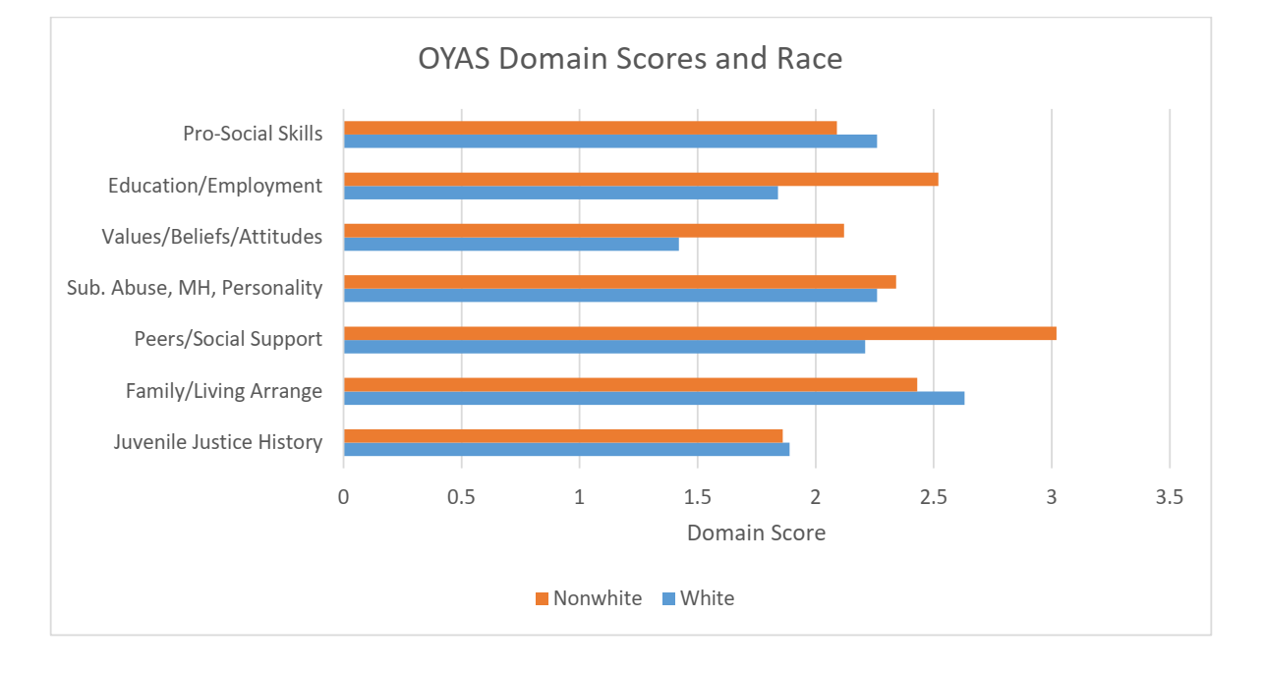
Oyas and race
(Butcher & Kretschmar, 2019)

Slide 37
Individual Items and Race
Subscale | Items | Black | White
JJ Involvement | 13 or younger | 43% | 34%
 | 1 prior | 18% | 23%
 | 2 or more | 46% | 30%
PSSN | Friends Fight | 35% | 19%
 | 50% or more friends arrested | 44% | 30%
 | Friends part of a gang | 18% | 5%
 | Arrested with friends | 55% | 44%
 | 50% or more friends suspended/expelled from school | 44% | 29%
School | Suspended from School - Ever | 93% | 77%
 | Suspended from School - 6 months | 45% | 38%
 | Expelled from school | 44% | 30%

Slide 38
Could these factors be proxies?

Slide 39
Recidivism
Race
Peers and Social Networks
Variability in recidivism is largely explained by race
Variability in Peers and Social Networks is also explained by race
The shared variability in Peers and Social Networks and Recidivism exists but amounts to very little overall
Ultimately the variability in recidivism explained by race is explained by the variability in Peers and Social Networks that is also explained by race.

Slide 40
Do the algorithms work equally well for all races?
1.C
Predictive equity:
The tool is equally accurate in its classification of different racial & ethnic groups.
Minimized impact on disparities:
On average, different groups are similar in terms of risk scores, categories & underlying factors.

Slide 41
Mis-classification
High Risk
Moderate
Low Risk

Slide 42
Because an instrument predicts well in the aggregate does not mean it predicts risk with every subpopulation
VanBenschoten, 2008

Slide 43
Ohio Youth Assessment System: A closer look at the Research
RNR tool designed to measure risk for recidivism
Intended to inform decision-making around treatment and intervention
5 separate tools
Diversion, Disposition, Detention, Residential, Reentry
Disposition is most widely used and studied
Disposition tool consists of 7 subscales
Juvenile justice history
Family and living arrangements
Peers and social support network
Education and employment
Pro-social skills
Substance abuse/ mental health
Values beliefs and attitudes
7 scales summed up to create total score which is then converted to (Low, Moderate, High)
Used in several states across the US including Ohio, Illinois, and Arizona

Slide 44
Does the total score predict recidivism?
McCafferty (2018) study of youth from 33 counties in Ohio
AUC Values by Race

Slide 45
McCafferty (2018) Recidivism Rates by Race
Two observations
OYAS is discriminating between Low, Moderate, and High categories fairly well
Recidivism rates are higher for Black youths in nearly every category
NOTE
If treatment decisions are based on risk, and overprogramming can increase your risk, it is not surprising that recidivism rates increase with risk level.

Slide 46
Is the story over?
OYAS by Race
OYAS categories | Race |  |  | Total
 | black | other | white
low | 355 | 44 | 131 | 530
 | 67 % | 8.3 % | 24.7 % | 100 %
 | 49.6 % | 61.1 % | 61.5 % | 52.9 %
moderate | 273 | 25 | 69 | 367
 | 74.4 % | 6.8 % | 18.8 % | 100 %
 | 38.1 % | 34.7 % | 32.4 % | 36.7 %
high | 88 | 3 | 13 | 104
 | 84.6 % | 2.9 % | 12.5 % | 100 %
 | 12.3 % | 4.2 % | 6.1 % | 10.4 %
Total | 716 | 72 | 213 | 1001
 | 71.5 % | 7.2 % | 21.3 % | 100 %
 | 100 % | 100 % | 100 % | 100 %
χ²=15.875 · df=4 · Cramer's V=0.089 · p=0.003
A larger proportion of Black youths are classified as high risk

Slide 47
Youth Level of Service/Case Management Inventory
Study of item level differential functioning in Indigenous and non-Indigenous youth in Canada – YLS/CMI
Scores predicted recidivism in non-Indigenous youth but not in Indigenous youth (Huang et al., 2021)
Indigenous youth were more likely to have substance use items endorsed
Justice history predicted recidivism for White youth but not Black youth (Miller et al., 2021)

Slide 48
State of the research
Predictive accuracy
Disparity in categories
Disparity in subscales
Disparity in items
Criminal history
Some evidence for accuracy across racial groups
Fairly problematic
Black males are more frequently categorized as high risk
Subscales may not be consistent across race
Items are not endorsed at the same rate and may not indicate risk in the same way
Criminal history does not predict recidivism risk across racial groups

Slide 49
Where does research on rnr tools go from here?
Examine how removing static factors such as criminal history will change the instrument
Examine whether factor structures hold across race
If not, examine whether and how a tool should be conceptualized and scored differently by race
Examine item level differences across race
Are there items that are endorsed more for BIPOC involved in the justice system?
Do these items measure risk or are they simply inflating the score in BIPOC?

Slide 50
Three considerations
The tool
Where is the tool used
How is it being used
Is the tool itself perpetuating bias?
The point in the CL system the tool is used can influence the collateral consequences of bias.
Human use of the tool can compound biased outcomes for individuals.

Slide 51
2) Where is the tool being used?
Pretrial
Diversion/Treatment
Probation
Notes:
This matters because there are different ways that tools are used at each of these point.
Each of these points has different benefits if used well and different collateral consequences if used poorly

Slide 52
3) How is the tool being used?
PRETRIAL
Using Well – reducing pretrial use of jail
Decrease Disparities – limits bias in decision makers and results in greater release rates for BIPOC
Using Poorly – net widening, increasing number of people on pretrial supervision
Increases Disparities – BIPOC are more likely to have overly-intensive mandates that are disruptive to lives and increase likelihood of pretrial failure.

Slide 53
3) How is the tool being used?
DIVERSION
Using Well – Increasing positive outcomes for growth, recovery, employment, and wellness
Decrease Disparities – works to reduce recidivism factors by supporting needs and connection to services
Using Poorly – Placed individuals in overly intensive programming that disrupts positive live outcomes
Increase Disparities – if in overly intensive treatment increases likelihood of failure and risk.

Slide 54
3) How is the tool being used?
PROBATION
Using Well – Appropriately tailoring supervision and supportive services
Improve Outcomes – increase community safety and connect individuals to meaningful supportive services for successful reentry.
Using Poorly – Being assigned overly intensive supervision and mandates that are more likely to result in failure
Increase Disparities – can result in higher rates of revocations for BIPOC which increases risk.

Slide 55
How to improve outcomes for BIPOC?
Creating Positive Outcomes With Risk Assessment

Slide 56
Mitigating Racial Bias
Mitigate racial bias in the tools
1
Mitigate racial bias in the process
2
Mitigate racial bias in the people
3

Slide 57
Mitigate Bias in the Tools
1. Different scoring thresholds by race
2. Make sure the tool is equally accurate for all racial groups
3. Make sure you track false positives and over-classification for BIPOC
4. Consider using other metrics such as treatment success

Slide 58
Mitigating Bias in the process
Make sure the tools are being used in the ways they are intended!
Research the outcomes to identify if there are disparities for BIPOC in bail, pretrial release, program diversion, and probation revocation.
Make sure policy decisions around tools are consistent across races.
Reduce disparities at every intercept point.
Notes:
1. Using tools to determine amount of bail set. NONONO. Also COMPAS at pretrial?

Slide 59
Mitigating Bias in the People
1. Be aware of your personal bias and its impacts.
2. Track and review all overrides for disparities.
3. Racial bias trainings for judges, prosecutors, public defenders, and correction officers.
4. Collect and review disparity outcomes for each phase of your program.
5. If disparities are present try to identify why and change court practices or procedures.

Slide 60
SUMMARY
1. All current risk tools have racial bias.
2. Risk assessment tools have been found to have both positive and harmful outcomes for BIPOC.
3. Careful construction and implementation of tools is essential to ensure that tools are resulting in positive and not negative results for BIPOC.
4. Research into fixing racial disparity in RNR tools is in early stages.

Slide 61
Contact Info
Adelle Fontanet-Torres, Esq.
Director, Tribal Justice Exchange
Afontanet@nycourts.gov
Fredrick Butcher, PhD.
Principal Research Associate
fbutcher@nycourts.gov

